Slide 1
Cancer type identification
Easy Company

Slide 2
THEME
As skin cancer is one of the most frequent cancers globally, accurate, non-invasive dermoscopy-based diagnosis becomes essential and promising. A task of Easy Company’s Deep Learning CNN model is to predict seven disease classes with skin lesion images, including melanoma (MEL), melanocytic nevus (NV), basal cell carcinoma (BCC), actinic keratosis / Bowens disease (intraepithelial carcinoma) (AKIEC), benign keratosis (solar lentigo / seborrheic keratosis / lichen planus-like keratosis) (BKL), dermatoﬁbroma (DF) and vascular lesion (VASC) as deﬁned by the International Dermatology Society.

Slide 3
Dataset
Dermoscopic lesion images were acquired from HAM10000 Dataset. A disease label for each image was determined histopathologically or diagnostically. A training dataset for classiﬁcation consisted of 10,015 images (327 AKIEC, 514 BCC, 1,099 BKL, 115 DF, 1,113 MEL, 6,705 NV, and 142 VASC samples) with the corresponding disease label (ground truth), and a validation set and a test set.

Slide 4
Types of Skin Cancer
Melanocytic Nevi (NV)
Melanoma (MEL)
Benign Keratosis-like Lesion (BKL)
Dermatofibroma (DF)
Basal Cell Carcinoma (BCC)
Actinic Keratoses (Akiec)
Vascular Lesions (Vasc)

Slide 5
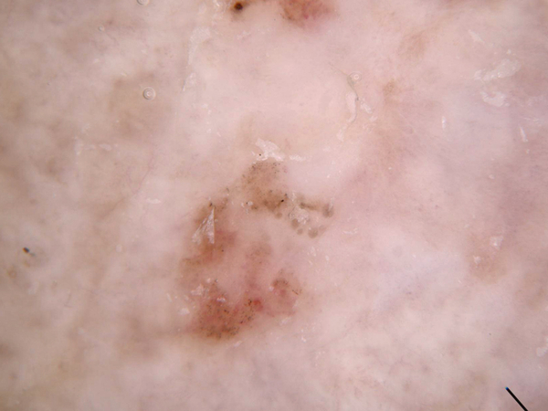
Actinic Keratoses (Akiec)

Slide 6
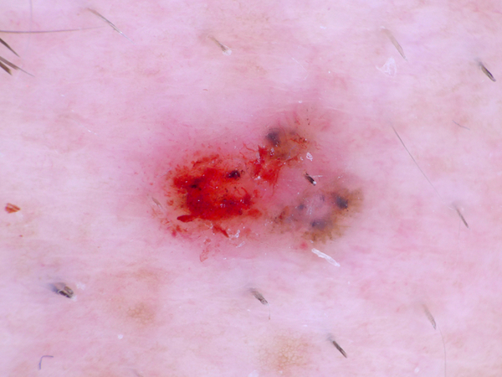
Basal Cell Carcinoma (BCC)

Slide 7
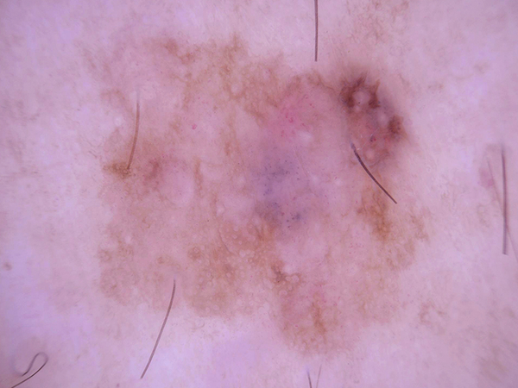
Benign Keratosis-like Lesion (BKL)

Slide 8
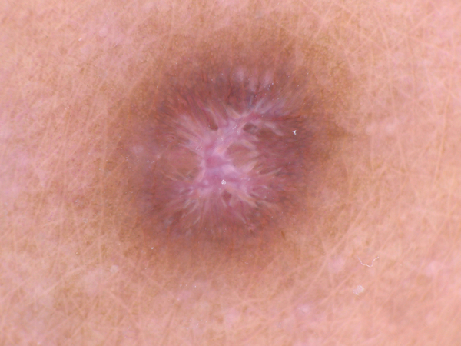
Dermatofibroma (DF)

Slide 9
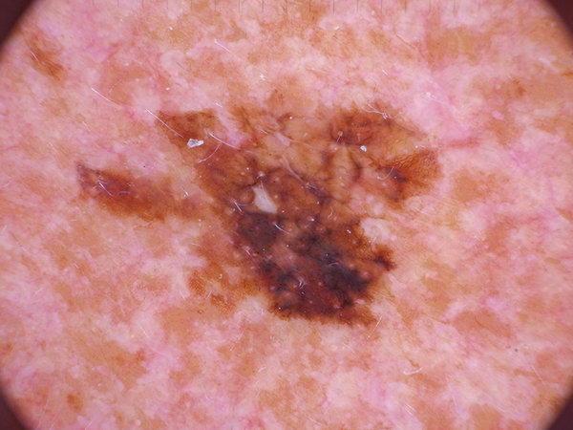
Melanoma (MEL)

Slide 10
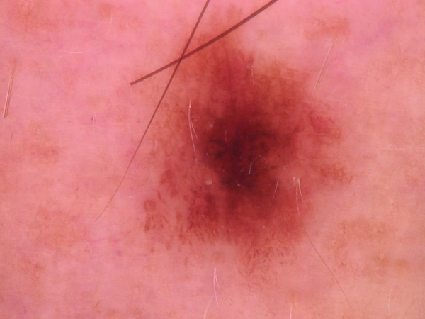
Melanocytic Nevi (NV)

Slide 11
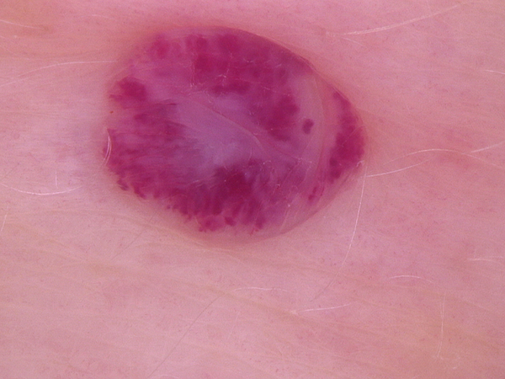
Vascular Lesions (Vasc)

Slide 12
Societal good
Skin cancer is one of the most common cancers that has been increasing world wide. Due to diverse characteristics in benign lesions and specific lesions seen from diseases, distinguishing fatal skin cancer from other skin disorders (with the potential of cancer) is VERY IMPORTANT.
Finding out the type of cancer can take months for doctors as it is a very tedious practice and also requires the use of expensive devices and contraptions. This would waste a good lot of time for the patient which could have been utilized by the doctors to treat the patient in time. It is also monetarily very demanding on the patient’s part, which could pose a problem if the patient is not financially settled.
Our Deep learning CNN model has been trained with 10015 pre-determined skin cancer type images to accurately predict what type of cancer (or skin disease) the given patient is facing.

Slide 13
Business Model
Integrating this Deep Learning model into an android app or some website or web utility, we can sell this to various medical institutions treating cancer at a large scale.
A minimal level of clerical knowledge and experience will then be sufficient for anyone to easily run our integrated model on any server/ device available in various hospitals. This can shorten the time taken to determine the type of skin disease drastically, saving days of diagnosis and also putting less hamper financially.

Slide 14
Tools and Algorithm used
Jupyter Notebook
Convolutional Neural Network (CNN)
Adam optimizer
Skin cancer dataset from Kaggle

Slide 15
CONCLUSION
A cancer patient goes through a lot and we as a society must be there for them in such dire situations. If we can save them the time they need to decide and plan their future by drastically reducing the time taken to detect their type of cancer at an early stage, we are bringing them one step closer to a happier life. Happiness is key when going through such an emotional run. Detecting the type of cancer at an early stage makes sure we can treat them if not cure them. This is crucial to medical institutions all around the globe if they want to make sure they can successfully treat the cancer patient.

Slide 16
EASY COMPANY
Mayur Raj Bharati
Nilim Sharma
Swagat S. Bhuyan

Slide 17
THANK YOU

